Slide 1


Toward improved data quality in public health: analysis of anomaly detection tools applied to HIV/AIDS data in Africa
Maryam OLANIYAN and Adebowale OWOSENI
African Village (Tech Innovation), Lagos, Nigeria
De Montfort University, Leicester, UK

Slide 2

Presentation Structure
Introduction
Methodology
Results
Implication
Summary & Conclusion

Slide 3

Introduction
1 Background of Study: What is Data Quality Assessment (DQA)?
Understanding the level of confidence in health facility data.
Discovering problematic areas in generating quality data.
2 The Problem
The current method of DQA does not provide DQ support at the facility level of reporting.
The current DQA method due does not adhere to Big data characteristics for public health data.
3 Research Aim
Identifying and implementing unsupervised anomaly detection methods for improving data quality assessment in public health.
Source: Young African Leaders Initiative

Slide 4
Introduction
Objectives
Evaluate the current method and technique used in assessing data quality in public health.
Suggest a suitable method for improving the assessment of data quality in public health.
4 Research Questions
Does the current method used in DQA have the standard to assess data quality in public health?
Is there a better method of assessing data quality in public health?
Source: Young African Leaders Initiative

Slide 5
Methodology
Employed qualitative research approach; Pregnant women receiving antenatal care (PMTCT) from PEPFAR at the reporting level hierarchies from 2016 Q1 – 2021 Q1.
The analysis focuses on the best method for determining data completeness and identifying outliers.
Analysis Approach
Analyse WHO Tool: WHO Tool was profiled for data quality by manually aggregating facility reported values, reviewed threshold and viewing results.
Analyse in Python: Pandas data frame imports the data into the Python notebook, each step finds data incompleteness, and anomalies using the PyCaret library. View results as plots of uMap and tSNE.
A comparison approach is used to evaluate the strengths and limitations of both methods.

Slide 6
Results
Data Completeness:
The Python method provided a better suited and more accurate result for reporting completeness over the WHO DQA toolkit.
The unsupervised anomaly detection model required data preprocessing to deal with missing values. Therefore, a statistical imputation algorithm was applied to input the mean of the reported values at each facility level in the missing rows.
Data Consistency (Outlier Detection):
The suggested model automates detecting outliers and the isolation forest algorithm gave the most accurate model for detecting outliers in the data.
Data Consistency (Time):
The time-series anomaly detection method requires timestamps for each facility recording service delivery to be implemented. The WHO tool provides an excellent at-a-glance view of the consistency of reporting over the last three years.

Slide 7
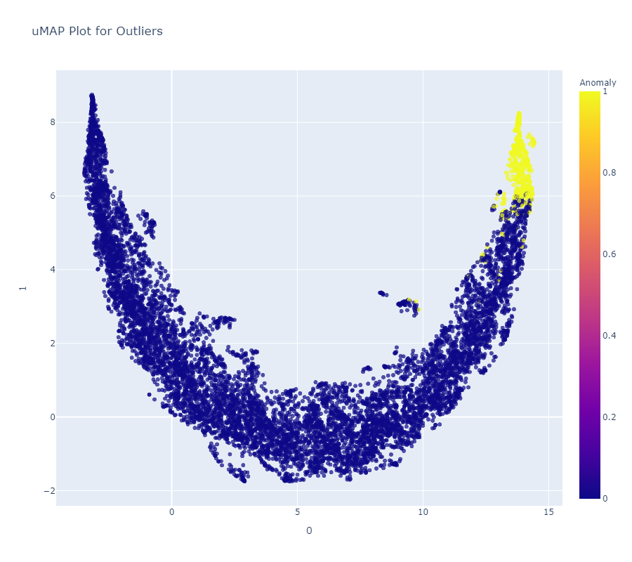
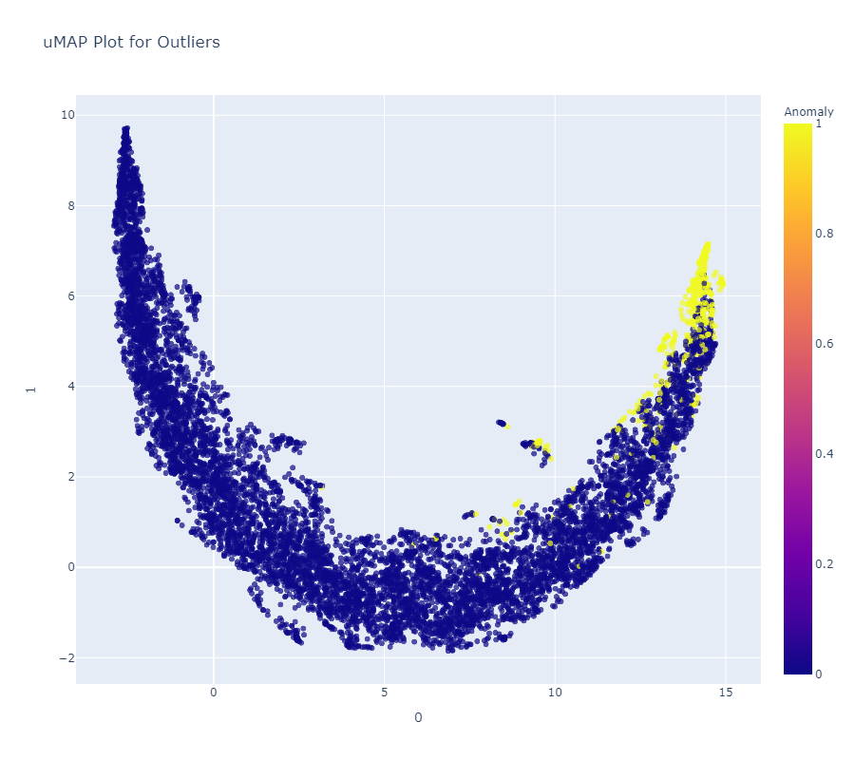
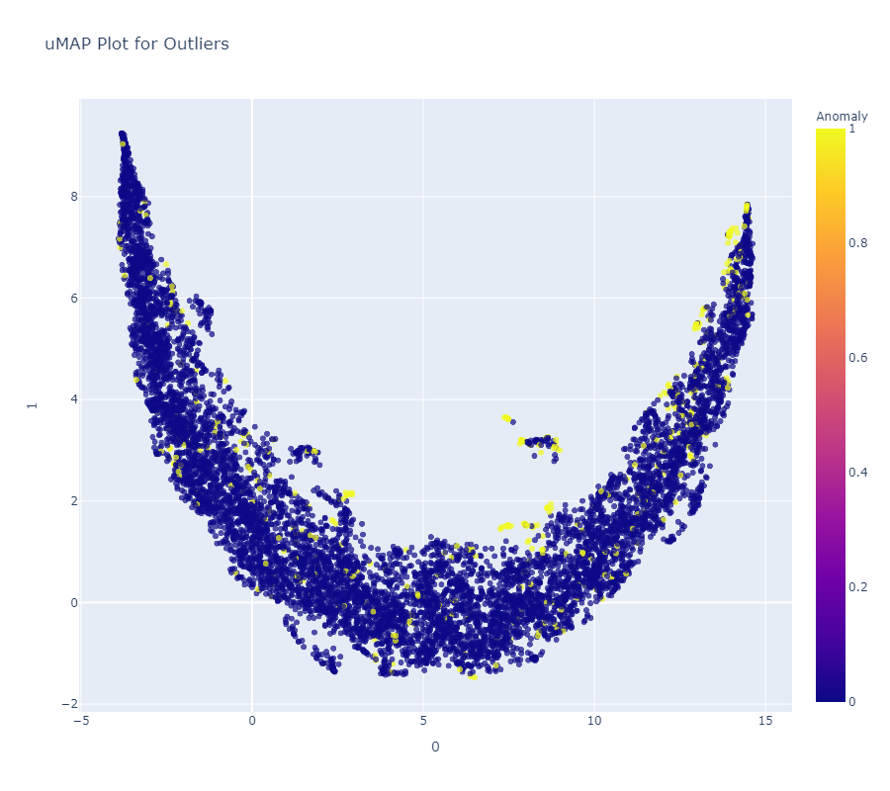
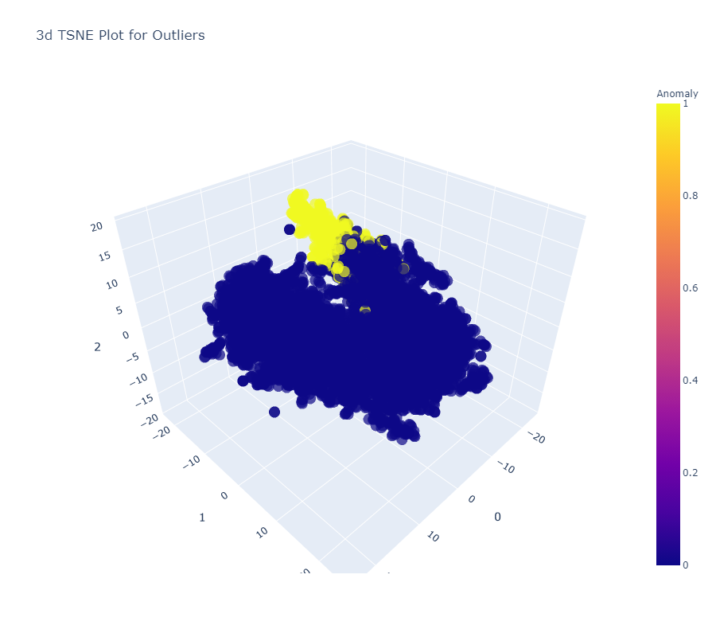

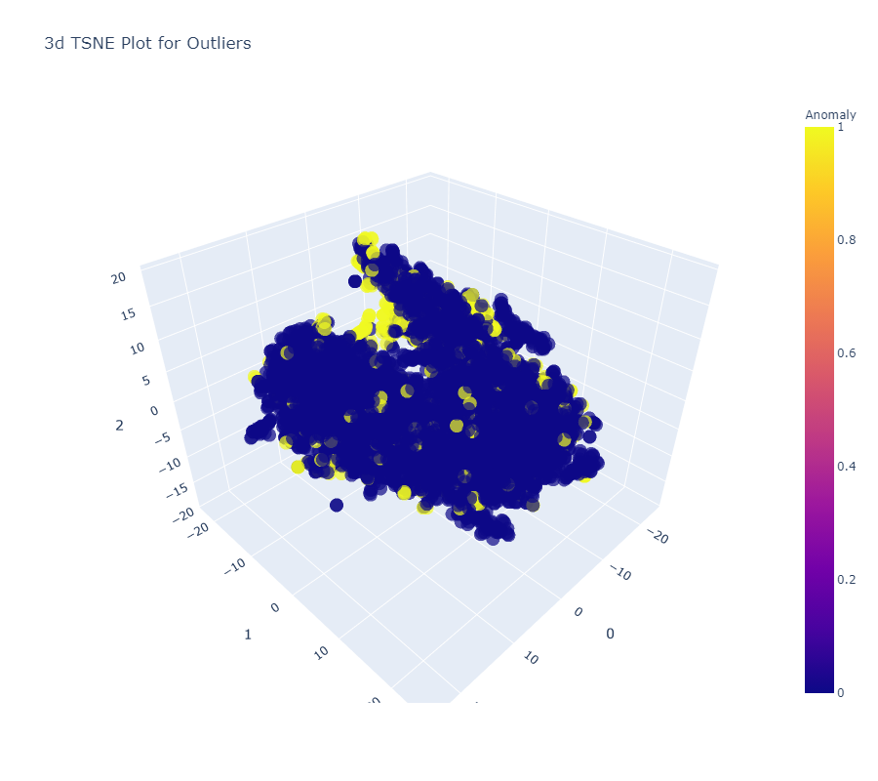

Results (Cont’d)
Isolation Forest
k-Nearest Neighbours
Local Outlier Factor
Isolation Forest
k-Nearest Neighbours
Local Outlier Factor

Slide 8
Implications
  The study suggests that the current method of ensuring data quality in public health by WHO requires manual aggregation and imputation of data which is time-consuming and unrealistic for the large volume of data generated by healthcare organisations.
  The anomaly detection technique is replicable and more accurate since the process is scalable. Consideration should be given to anomaly detection algorithms in assessing data quality at the facility level.
  One of the limitations of this recommendation is the digital skills gap among health workers at the local level. The workers appear more used to Microsoft Excel, but the use of WHO could continue to impede the reliability of health data analysis and the quality of decisions made from such research.

Slide 9

Summary & Conclusion
Python EDA method of identifying missing values if more reliable for the volume of data process for HIV site PMTCT data.
PyCaret’s Isolation Forest detects anomalous data at facility levels more accurately and quicker than the WHO DQ Tool making it the superior approach
Consistency over time requires a better record of time series to help access PyCaret’s Time Series Anomaly detection modules. Therefore, the WHO Method is retained.
Conclusions from research objectives:
Does the current method used in DQA have the standard to assess data quality in public health? The research shows that the WHO DQA tool poorly identifies data completeness and the presence of outliers hence, the need for an improved method is valid.
Is there a better method of assessing data quality in public health? The research proves unsupervised anomaly detection model can improve DQA in public health.
Further research will evaluate the Implementation of PyCaret anomaly detection algorithm on non-HIV data from other public health stakeholders to validate model performance

Slide 10

Questions?

